Slide 1
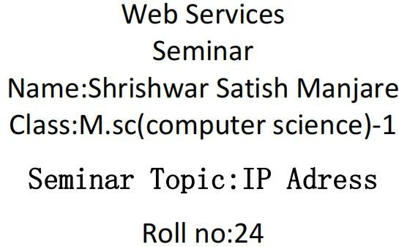

Slide 2
ip address : -
ip stands for "Internet Protocol,"
which is the set of rules governing the format of data sent via the
internet or local network. In essence, IP addresses are the identifier that allows information to be sent between devices on a network: they contain location information and make devices accessible for communication.
There are four types of IP addresses:
Public Private Static
dynamic
1. public:-
A public IP address is an IPv4 address that is reachable from the internet. If a resource in your tenancy needs to be directly reachable from the internet, it must have a public IP address
2. private:-
A private IP address is a range of non-internet facing IP addresses used in an internal network. Private IP addresses are provided by network devices, such as routers, using network address translation.

Slide 3
Internet Protocol (IP) addresses identify a device on either the internet or
a local network.
3. Static:-
If your computer is hosting a web server, its IP address is what identifies it to the rest of the Internet. A computer on the Internet can have a static IP address, which means it stays the same over time, or a dynamic IP address, which means the address can change over time.
4. dynamic:
What is the difference between a dynamic and static IP address? When a device is assigned a static IP address, the address does not change. Most devices use dynamic IP addresses, which are assigned by the network when they connect and change over time.
What are port addresses?
An IP address identifies a machine in an IP network and is used to determine the destination of a data packet. Port numbers identify a particular application or service on a system.

Slide 4
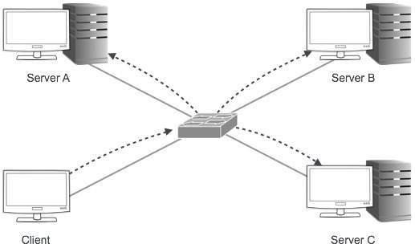
Some common ports are Universal Serial Bus ports, USB-C ports,
Ethernet ports or DisplayPorts. Some older ports no longer in common use are serial ports, parallel ports and mouse/keyboard PS/2 ports.
What are the 3 types of port?
There are different types of ports available: Serial port. Parallel port. USB port
IPv4 - Addressing

Slide 5
192.158.1.38
Ex .ip address:-
counrty
state
internet provider
device

